Slide 1
ICS3C0 / ICS4C0 (Grade 11 / 12 Computer Science)
Mr. Nestor
(gregory.nestor@peelsb.com)
(p0079141@pdsb.net)

Slide 2
Module A1.1 – Sep 07
Agenda
Attendance / Introductions
Module A1.1 - Nethack Game – Level 3
Debrief Questions – Level 2
Upcoming
Monday: Course Outline

Slide 3
Resources
Nethack Online
https://alt.org/nethack/
Nethack Guidebook
Nethack Open Source
https://github.com/NetHack/NetHack

Slide 4
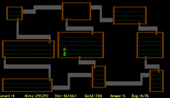
Debrief – Level 2
Rogue came before Nethack.
What have you found out so far…
Language?
Hardware?

Slide 5
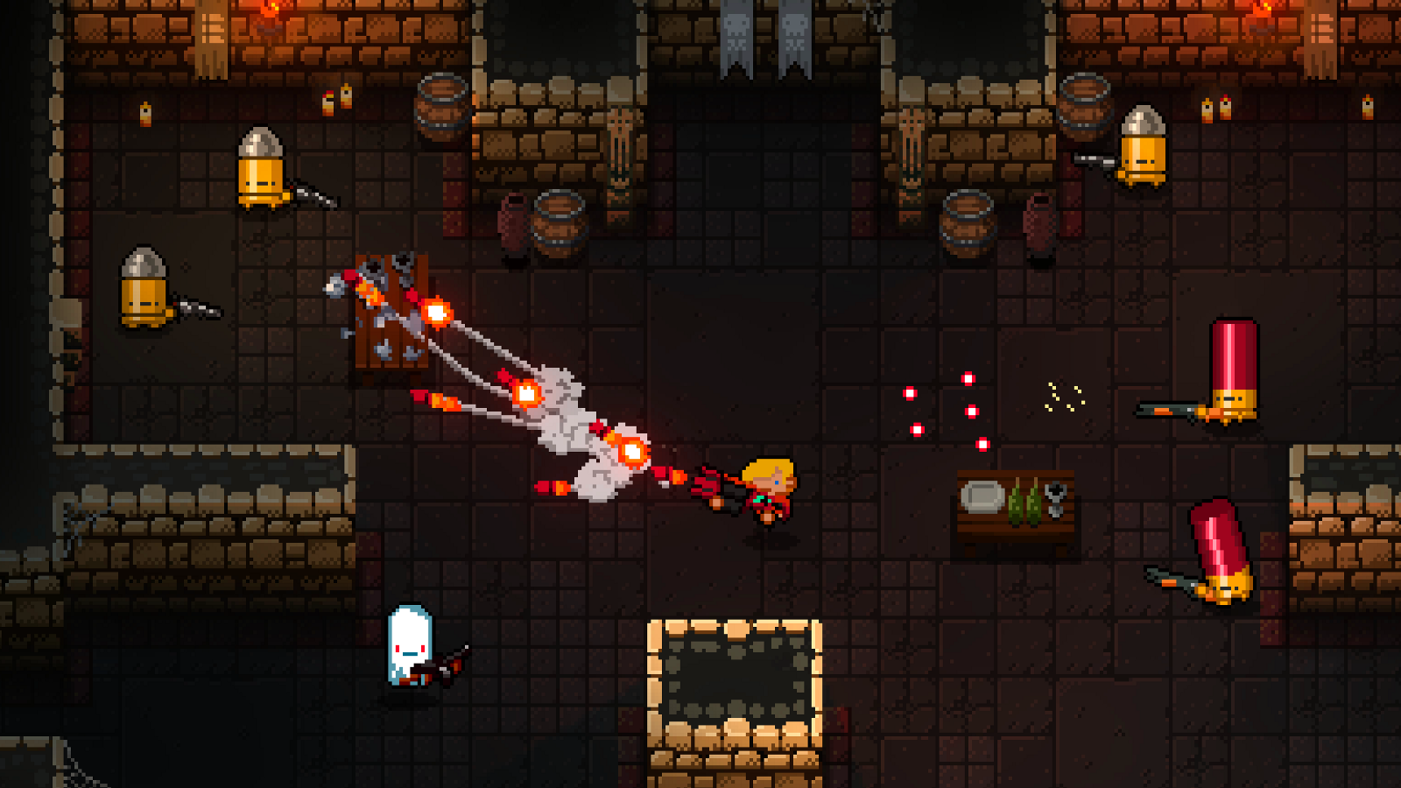
Debrief – Level 2 (Cont’d)
“Rogue Like” games - Evolution

Slide 6

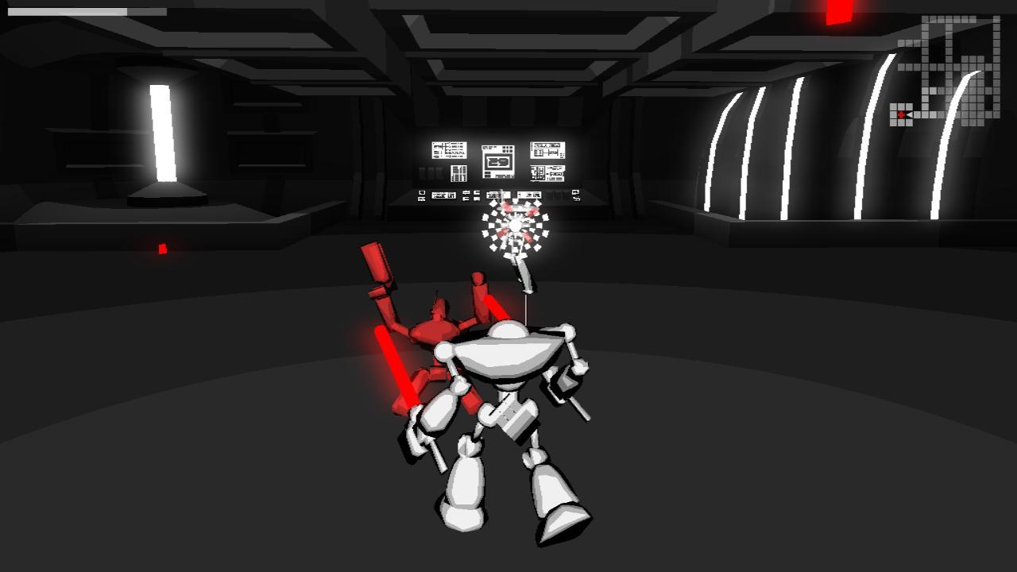
Debrief – Level 2 (Cont’d)
“Rogue Like” games - Evolution

